Slide 1
Dynamic Resource Allocation May 1, 2014

Slide 2
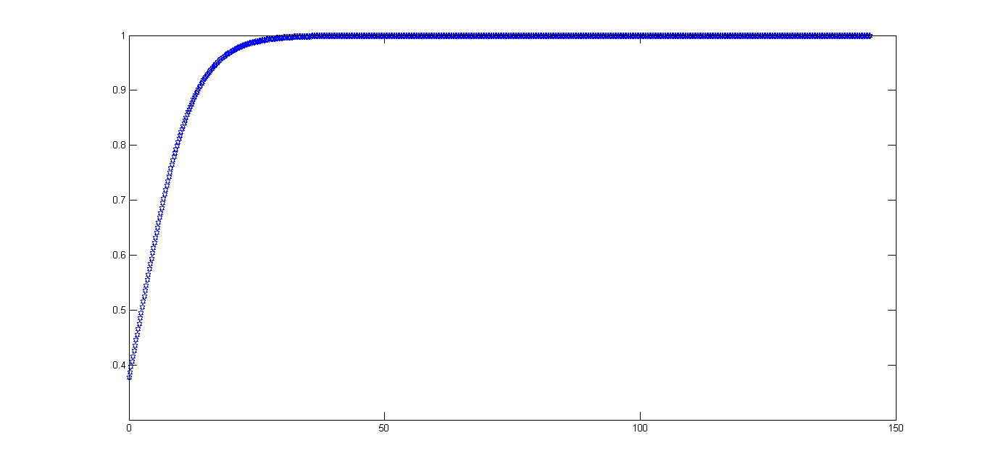
Distance Threshold Function
Multiply probability of abandoning target by value of sigmoid at that distance
Sigmoid parameters can be tweaked but decent results with this function
Nearby targets are almost never abandoned

Slide 3
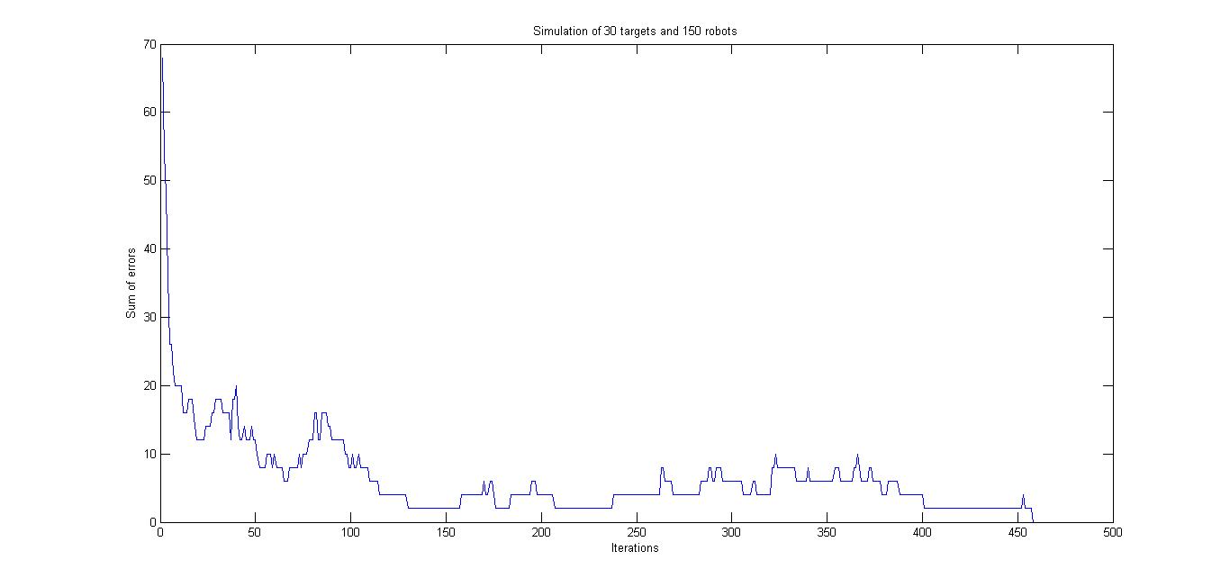
Representative Simulation Results
30 targets, 150 robots
Took 3 seconds to go from 70 errors to zero
At each time step robots move 1% of the way towards current target in straight line

Slide 4
Misc
Most of the week was final project
Placed deposit on apartment in Ft Walton
Cleaned out the closet/office for Ben
Followed the change reporting procedure for workload
Will e-mail Dr. Whiteman tomorrow if I don’t hear from the office I emailed

